Slide 1
Lecture 7
System Analysis
and Design

Slide 2
Chapter 5
_{Information Gathering}
Chapter 5
SP

Slide 3
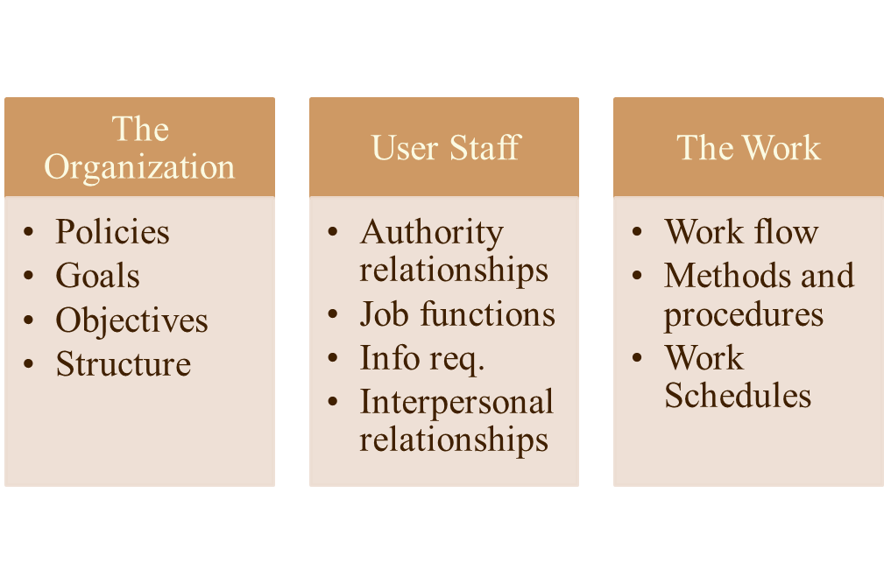
What Kinds of Information Do We Need
Categories of Information
Chapter 5
SP

Slide 4
Where Does Information Originate?
Information is gathered from two principal sources:
Personal or written documents from within the organization
From the organization’s environment
They are also called internal and external sources.
Chapter 5
SP

Slide 5
Primary Internal Sources
The primary internal sources are
Financial reports
Personnel staff
Professional staff (For example: Legal counsel, EDP auditor, etc)
System documentation or manuals
The user or user staff
Reports and transaction documents
Chapter 5
SP

Slide 6
Primary External Sources
The primary external sources are
Vendors
(For example: Hardware and other equipment manufacturers)
Government documents
Technical newspapers and professional journals
Chapter 5
SP

Slide 7
Information gathering tools
A key part of feasibility analysis is gathering information about the present system. The proper use of tools for gathering information is the key to successful analysis.
The tools used in information gathering are:
Review of written documents
On-site observations
Interviews and
Questionnaires
Chapter 5
SP

Slide 8
Review of written documents
As a first step, a search of the literature through professional references and procedures manuals, textbooks, company studies, government publications, or consultant studies may prove invaluable.
Drawbacks.
Procedures manuals and forms are useful sources for the analyst. They describe the format and functions of the present system.
Drawbacks.
Chapter 5
SP

Slide 9
On-site observations
It is the process of recognizing and noting people, objects, and occurrences to obtain information.
The major objective of On-site observation is to get as close as possible to the “real” system being studied.
The analyst’s role is that of an information seeker who is expected to be detached and unbiased from the system being observed.
Chapter 5
SP

Slide 10
Questions as a guide for On-site observation:
What kind of system is it? What does it do?
Who runs the system? Who are the important people in it?
What is the history of the system? How did it gets to its present stage of development?
Apart from its formal function, what kind of system is it in comparison with other systems in the organization? Is it a primary or a secondary contributor to the organization?
Is it a fast paced or a leisurely system that responds slowly to external crises?
Chapter 5
SP

Slide 11
Rules followed by an observer
As an observer, the analyst follows a set of rules:
While making observation, he/she is more likely to listen than talk.
And to listen with a sympathetic and genuine interest when information is conveyed.
The emphasis is not on giving advice or passing moral judgment on what is observed.
Care is taken not to argue with the persons being observed or to show hostility toward one person and undue friendliness toward another.
Chapter 5
SP

Slide 12
Alternative observation methods
When human observers are used, four alternative observation methods are considered:
Natural or contrived.
Obtrusive or unobtrusive.
Direct or indirect.
Structured or unstructured.
Chapter 5
SP

Slide 13
Deciding whether to use an On-site observation
What behavior can be observed that cannot be described in other ways?
What data can be obtained more easily or more reliably by observation than by other means?
What assurances can be given that the observation process is not seriously affecting the system or the behavior being observed?
What interpretations need to be made about observational data to avoid being misled by the obvious?
How much skill is required and available for the actual observation?
Chapter 5
SP

Slide 14
Drawbacks of On-site observations
Intruding into the user’s area often results in adverse reactions by the staff. Therefore, adequate preparation and training are important.
Attitudes and motivations of subjects cannot be readily observed - only the actions that result from them.
Observations are subject to error due to the observer’s misinterpretation and subjective selection of what to observe, as well as the subject’s altered work pattern during the observation.
Unproductive, long hours are often spent in an attempt to observe specific, one-time activities or events.
Chapter 5
SP

